Slide 1
COMPX304-23A
Advanced Networking and Cybersecurity
Week 11
Hardware Vulnerabilities
Vimal Kumar
Slides: Vimal Kumar, Chris Anderson, Panos Patros

Slide 2
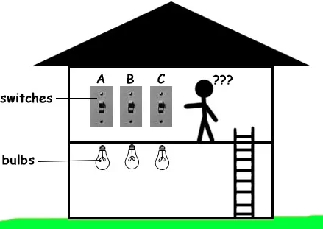

Guard with
Memory
Eraser

Slide 3
Side Channel attacks
In channel attacks
  Attacker uses the specified communication channel for attack
Side channel attacks
  The attacker uses unspecified input and output channels to convey system information
  Examples
    Timing
    Disk Usage
    Memory Usage
    Sound
    Power consumption
    Cache Usage

Slide 4
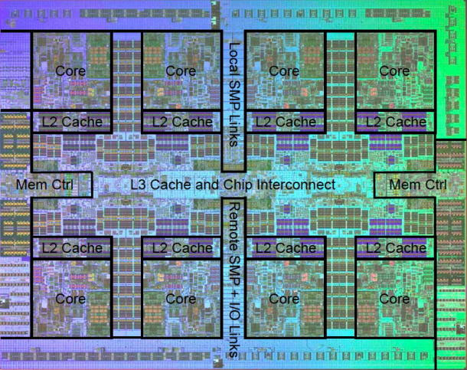
CPU Cache
A load 0x… is not just a load!
  The address is converted to its physical address and permissions are checked
  The address is looked up in the Level-1 (L1) cache. If not there,
  It’s looked up in the L2 cache. If not there,
  In the L3 cache, if not there
  From main memory (cache miss)
Each of these pathways take a significantly different time (CPU cycles) to complete
https://arstechnica.com/gadgets/2009/09/ibms-8-core-power7-twice-the-muscle-half-the-transistors/

Slide 5
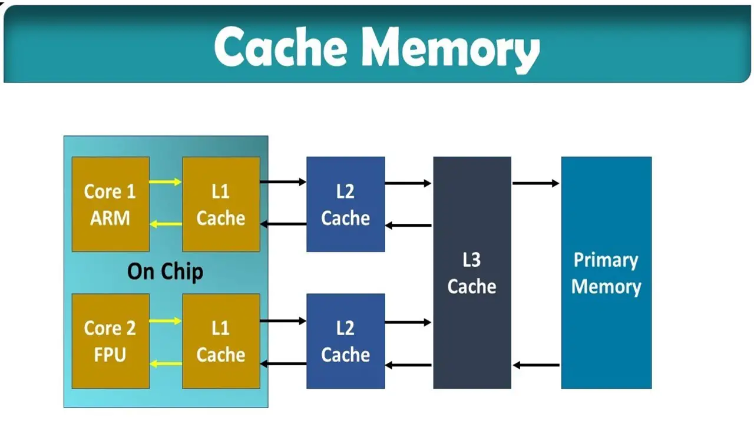
CPU Cache

Slide 6
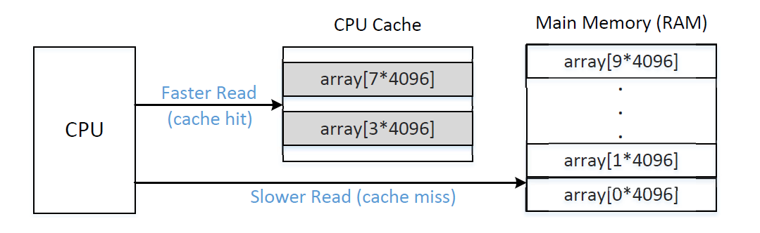
CPU Cache

Slide 7
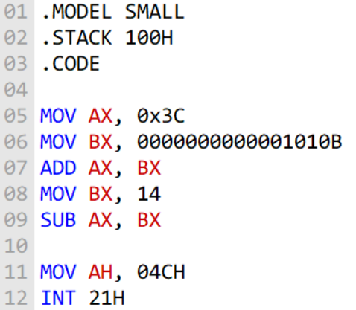
CPU Instructions (ISA)

Slide 8
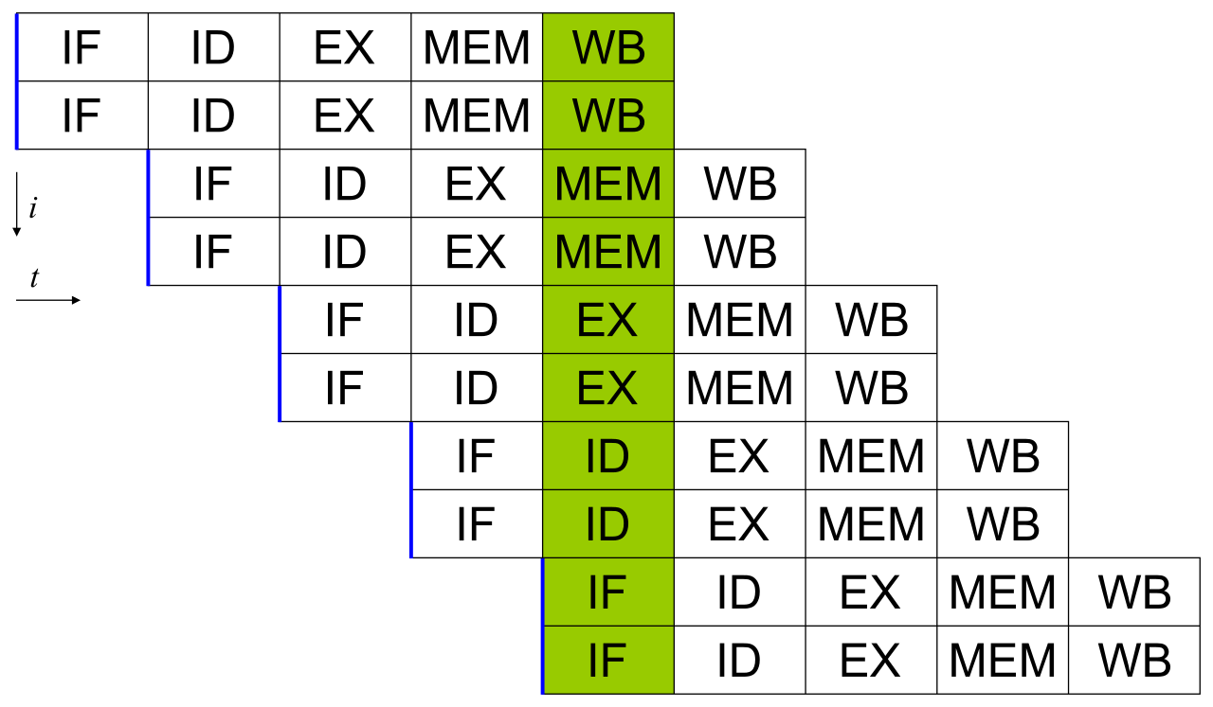
Superscalar Execution (aka pipelining)
ISA instructions are NOT executed one after the other!
  Nor do they take one cycle to complete!
  Instead, they are broken down to microarchitecture instructions
  Each can be executed by a different component in the CPU
Thus, we parallelize/pipeline them
  What if there is a branch?
https://en.wikipedia.org/wiki/Superscalar_processor

Slide 9
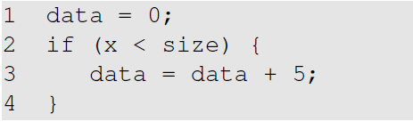
Speculative Execution
The CPU guesses/learns the path the program will follow and starts executing it by putting it into the pipeline
If it made a wrong guess, it flashes the pipe and starts from the right point undoing all changes it performed.

Slide 10
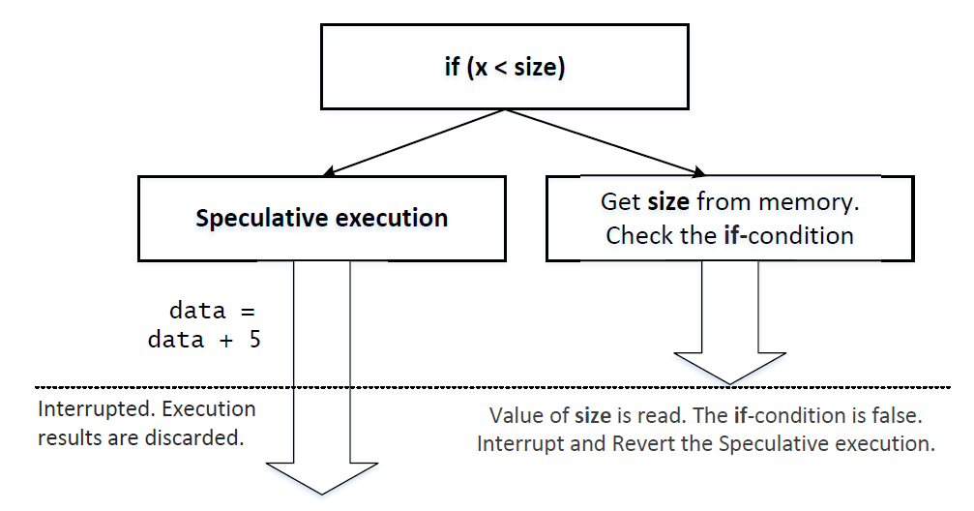
Speculative Execution
Processor manufacturers forgot about the Cache

Slide 11
The Meltdown attack
Attacker is a user program and is therefore in the user space.
The attacker’s motivation is to get hold of some confidential information in the kernel space.
  The user space/kernel space separation using the on board hardware prevents an attacker from doing it directly.
  The meltdown attack allows the attacker to do this using a side channel

Slide 12

From Lights to CPU Cache
Guard with
Memory
Eraser
Room = Kernel Memory
Secret number = Confidential kernel information
Guard = Access Control System. Uses the hardware to check if access is allowed.

Slide 13
From Lights to CPU Cache
User program. Tries to access secret value
The information accessed by the program is now hot in the cache. The program can now read the cache and therefore the secret value
Access control system: Checks Access but speculative execution causes delay, while the program instructions are executed

Slide 14
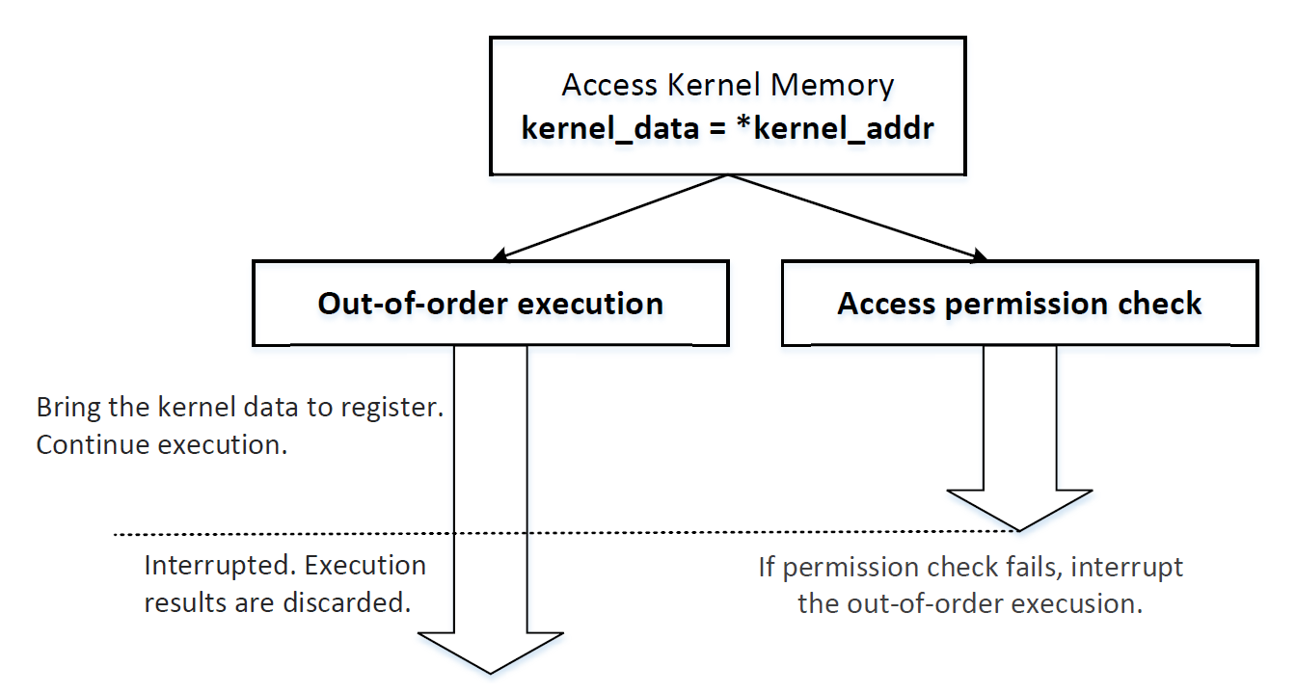
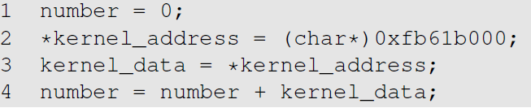
Speculative/Out-of-order Execution

Slide 15
Speculative/Out-of-order Execution

Slide 16
The Spectre attack
Makes use of speculative execution’s drawback too
Turns out you can (potentially) play this trick every time there is a condition in the code
CPUs try to make an educated guess of which execution path is likely to be taken.
  They do this by looking at which path was historically taken
A CPU can be fooled into taking the incorrect execution path by training it with the correct execution path
Eventually the CPU will correct itself but any data in the CPU cache as a result of the incorrect execution will not be erased

Slide 17
The Spectre attack
Many access control decisions are taken using conditional code
if ( read_permission == 1)
allow read
Spectre class of attacks exploits speculative execution to get access to resources without having the required permission

Slide 18
Spectre Overview
x
Phase 1
Mis-Train the CPU to speculatively execute the true branch of an if-statement.
Pick repeated valid values for x
array1
Sensitive data
for(…){
…
if (x < array1_size){
y = array2[array1[x] * 4096];
}
…
}
Based on https://spectreattack.com/spectre.pdf

Slide 19
Spectre Overview
x
Phase 1
Mis-Train the CPU to speculatively execute the true branch of an if-statement.
Pick repeated valid values for x
array1
Sensitive data
for(…){
…
if (x < array1_size){
y = array2[array1[x] * 4096];
}
…
}
Based on https://spectreattack.com/spectre.pdf

Slide 20
Spectre Overview
x
Phase 1
Mis-Train the CPU to speculatively execute the true branch of an if-statement.
Pick repeated valid values for x
array1
Sensitive data
for(…){
…
if (x < array1_size){
y = array2[array1[x] * 4096];
}
…
}
Based on https://spectreattack.com/spectre.pdf

Slide 21
Spectre Overview
x
Phase 1
Mis-Train the CPU to speculatively execute the true branch of an if-statement.
Pick repeated valid values for x
array1
Sensitive data
for(…){
…
if (x < array1_size){
y = array2[array1[x] * 4096];
}
…
}
Based on https://spectreattack.com/spectre.pdf

Slide 22
Spectre Overview
x
Phase 2-a
Make x much larger than the length of the array and try to read beyond it!
array1
Sensitive data
for(…){
…
if (x < array1_size){
y = array2[array1[x] * 4096];
}
…
}
Based on https://spectreattack.com/spectre.pdf

Slide 23
Spectre Overview
x
Phase 2-b
The CPU is tricked and starts speculatively executing parts of the true-branch without having completed the actual check yet!
array1
Sensitive data
for(…){
…
if (x < array1_size){
y = array2[array1[x] * 4096];
}
…
}
Based on https://spectreattack.com/spectre.pdf

Slide 24
Spectre Overview
x
Phase 2-c
An index for array2 is calculated: array1[x]*4096
Remember, array1[x] is sensitive data now! The index for array2 is sensitive too
E.g., if array1[x] is 0, the calculated index is 0. If it is 1, the index is 4096. If 2, 8192 and so on…
array1
Sensitive data
for(…){
…
if (x < array1_size){
y = array2[array1[x] * 4096];
}
…
}
array2
Based on https://spectreattack.com/spectre.pdf

Slide 25
Spectre Overview
x
CPU CACHE
Phase 2-d
An index for array2 is calculated: array1[x]*4096
The memory from array2 at that index is brought into the cache!
array1
Sensitive data
for(…){
…
if (x < array1_size){
y = array2[array1[x] * 4096];
}
…
}
array2
Based on https://spectreattack.com/spectre.pdf

Slide 26
Spectre Overview
Phase 2-e
The CPU realizes its speculative execution failed and stops trying to execute the true-branch.
It unrolls all changes it performed.
But leaves the cache as is!!?!
CPU CACHE
array1
Sensitive data
for(…){
…
if (x < array1_size){
y = array2[array1[x] * 4096];
}
…
}
array2
Based on https://spectreattack.com/spectre.pdf

Slide 27
Spectre Overview
x
array1[x] is 1!
Phase 3
The attacker measures the time it takes to load a byte from array2 at a cache-line distance.
They will all be slow except one! The one already in the cache! Its position reveals the value of array1[x]
CPU CACHE
array1
Sensitive data
for(…){
…
if (x < array1_size){
y = array2[array1[x] * 4096];
}
…
}
array2
Based on https://spectreattack.com/spectre.pdf

Slide 28
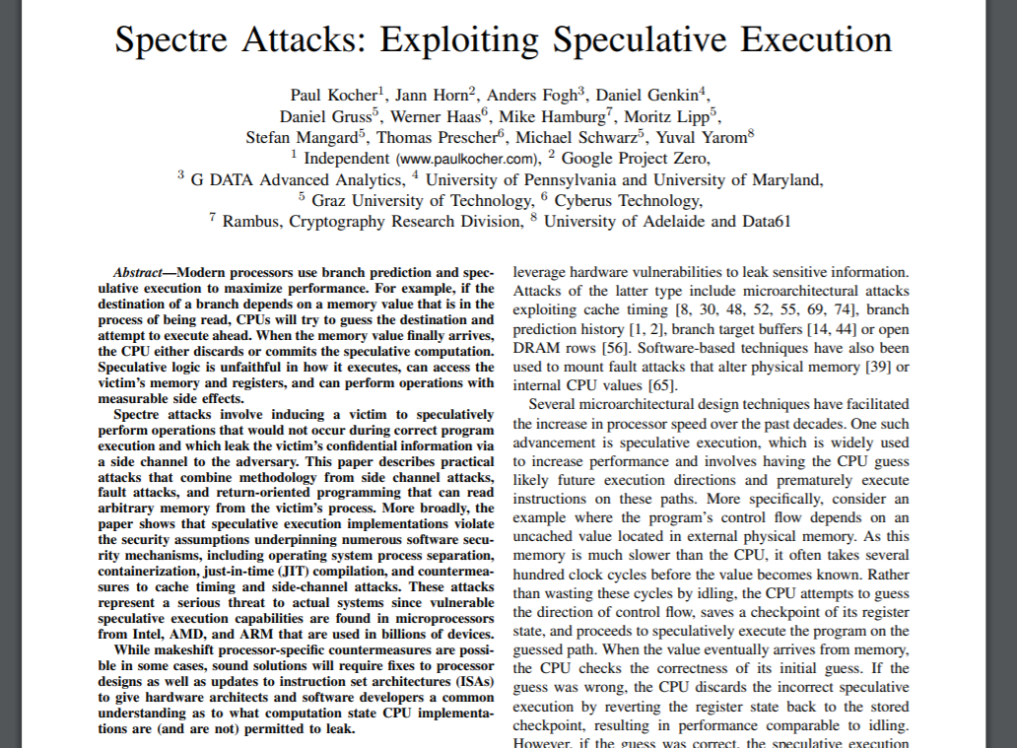
Kocher, Paul, Daniel Genkin, Daniel Gruss, Werner Haas, Mike Hamburg, Moritz Lipp, Stefan Mangard, Thomas Prescher, Michael Schwarz, and Yuval Yarom. "Spectre attacks: Exploiting speculative execution." arXiv preprint arXiv:1801.01203 (2018).

Slide 29
COMPX304-23A
Advanced Networking and Cybersecurity
Week 11
Secure Software Development
Vimal Kumar
Slides: Vimal Kumar, Chris Anderson, Panos Patros

Slide 30
What to do?
We’ve seen examples of vulnerabilities and attacks
Various levels
  Users/People, Software, Operating Systems, Hardware
Need for systematic approach for secure software
  Secure Software Development and Architecture
  Security Testing

Slide 31
Secure Coding Practices I
Do not trust User Input
  check nulls, types, reserved words, expected formats
Don’t ignore compiler warnings
Keep it simple!
Default deny
if !isUserAuthorised:
return;
authorizedAction()
if isUserAuthorised:
authorizedAction()

Slide 32
Secure Coding Practices II
Principle of least privilege
Sanitize data sent to other systems
Remember, multitier sanitization!!
  Validate sanitization functions you use!
    People copy random code from the Internet… ☹
  input = "<scr<script>ipt>nastyCode() </scr<script>ipt>"
  print singleLevelSanitize(input)
    <script>nastyCode()</script>
  print multiLevelSanitize(input)
    nastyCode()

Slide 33
Secure Coding Practices III
Reuse existing validated modules, frameworks, …
  Don’t write your own security code
  Don’t use low level languages unless needed
Check for integer overflows
Don’t compare floats with strict equality:
float a, b;
if(abs(a-b)>=threshold) //Good ☺
if(a==b) //Bad ☹
Check string lengths (buffer overflows)

Slide 34
Requirements
Core CIA (Confidentiality, Integrity, Availability)
Important extensions
  Authentication
    Identity verification
  Nonrepudiation
    Message ownership
  Authorization
    Privilege granting

Slide 35
Threat Modelling
Successful Denial of Service Attack
Threat Modelling using attack trees
  Root
    Successful Attack
  Nodes
    Conditions required for the success of the attack
  Logical operators
    Joining the conditions
Allows one to think about how systems can be attacked and how one can prevent the conditions that enable an attack
AND
High external load
Queued Requests Exceed Capacity
Can’t Scale
OR
CPU Intensive Requests
Requests not rejected

Slide 36
Security Testing
Effective QA
  Test plans, security requirements & regression testing
  Penetration tests
  Source code auditing
  Independent security reviews
  Automated toolchains
  Bug tracking tools
  Secure coding standards

